Slide 1
Vlatko Ivanovski
DevOps Lead @ Avanade UK&I
DevOps Metrics
Measuring What Matters

Slide 2
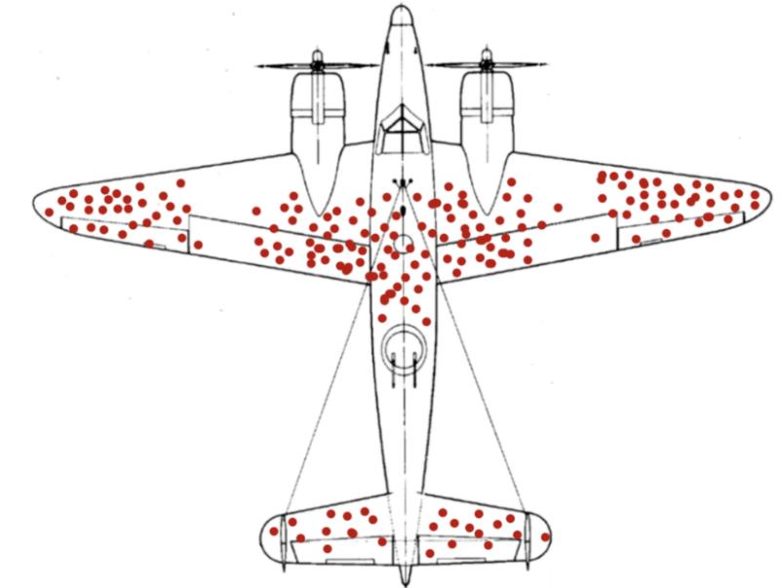
WWII – damage distribution analyzed
…reinforce the red clusters
Abraham Wald – mathematician:
Reinforce the areas that have not been hit
The aircrafts got hit in these areas did not return
Survivorship bias – fail to notice the value inspecting “failures” to understand “how to succeed”

Slide 3
Driving Collaboration Across the Development Lifecycle and IT Operations
DevOps is all about people, process, and technology, and applying principles and methods to drive better collaboration between your software delivery and IT operations teams.
Key Benefits of DevOps
Gain a competitive advantage
Increase IT resource efficiency
Enable better and faster decisions
Keep pace with business demands

Slide 4
Get on the Path to DevOps
Assess your DevOps strategy.
Identify the DevOps maturity of your core development and IT operations processes.
Adopt and implement change to improve velocity.
Measure progress and plan next improvement.

Slide 5
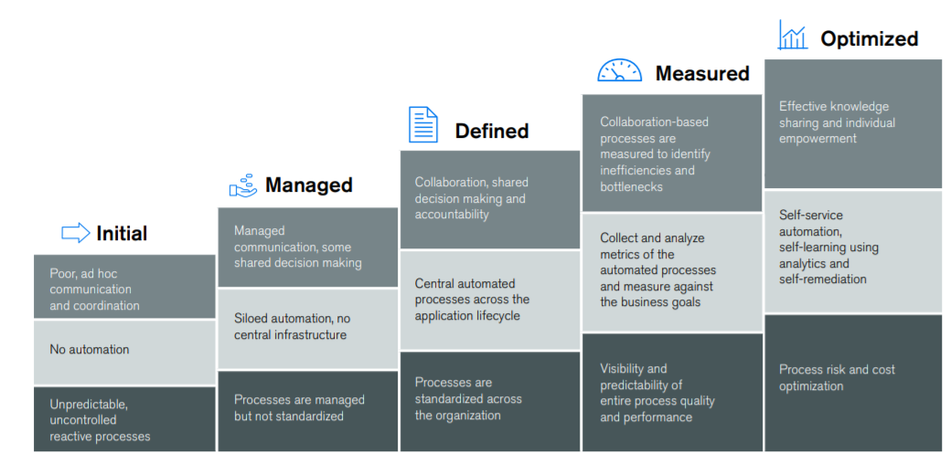
DevOps Maturity Model

Slide 6
Why Measurement?
Remove Subjectivity
Improve Excellence
Focus on Strategy
Create Predictability

Slide 7
What is key principle of measurement?
Ability to execute on a faster cadence (efficiency) and the ability to freely add more value (effectiveness) demand continuous change cycles.

Slide 8
Which classes of measurements matter most?
Three dimensions of measures:
Internal
Technical progress, product pipeline trends and resource consumption
External
Quality, usefulness, performance and business outcomes
Cultural
Team dynamic, process overhead, trustworthiness, morale, motivation etc.

Slide 9
Let’s start with few metrics?

Slide 10
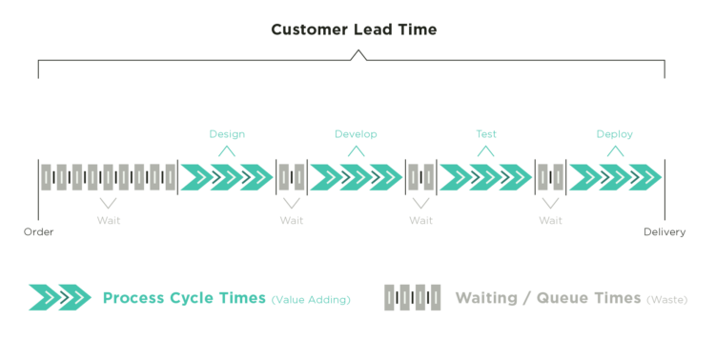
Lead Time
The elapsed time from receiving a customer request to delivering on that request. Lead Time = Process/Cycle Time plus Wait Time.

Slide 11
Process/Cycle Time
Process time begins when the work has been pulled into a doing state and ends when the work is delivered to the next downstream customer.

Slide 12
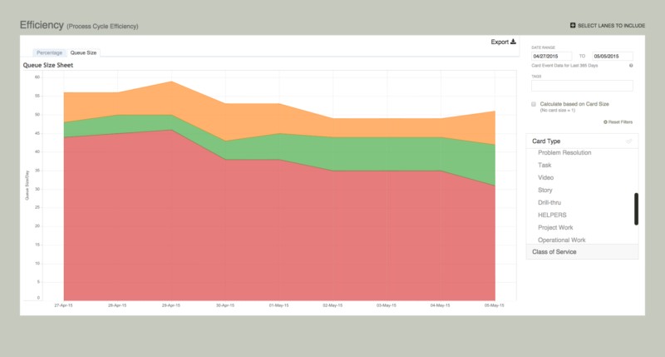
Wait Time / Non-value-adding process time
The time that work sits idle not being worked.

Slide 13
Code Deployment Lead Time
Two qualitatively segments of the technology value stream:
The Design and Development value stream
From hypotheses -> code is committed into version control repository.
The Testing and Operations value stream
Work is checked into version control- > deployed into production in single-pieceflow.

Slide 14
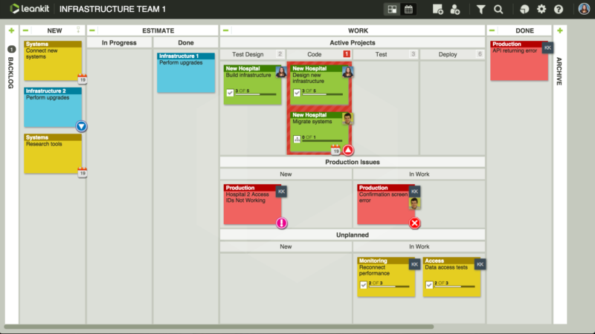
Work in Process or Work in Progress (WIP)
The amount of work in a system that has been started but not finished.

Slide 15
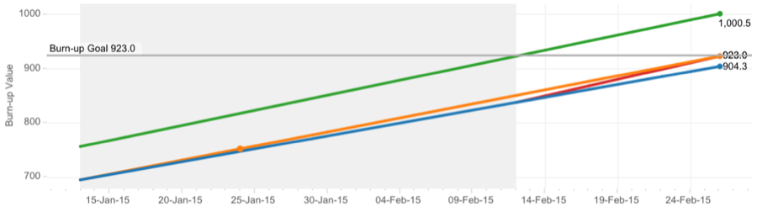
Throughput
Throughput is the average number of units processed per time unit. In a Kanban system, examples can include “cards per day,” “cards per week,” or “story points per iteration.”
15

Slide 16
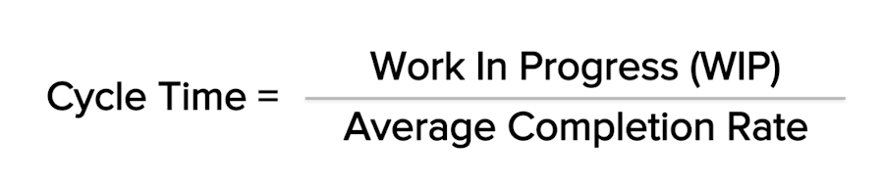
Little’s Law in Practice
Hypothetical demonstration of how changes made to the system’s input can impact the system’s output.

Slide 17
So what?
Provide actionable metrics !

Slide 18

If you don’t know where you’re going you might not get there – Yogi Berra

Slide 19
Value Stream Mapping
“…Value stream mapping (VSM) provides us with a structured visualization of the key steps and corresponding data needed to understand and intelligently make improvements that optimize the entire process…”

Slide 20
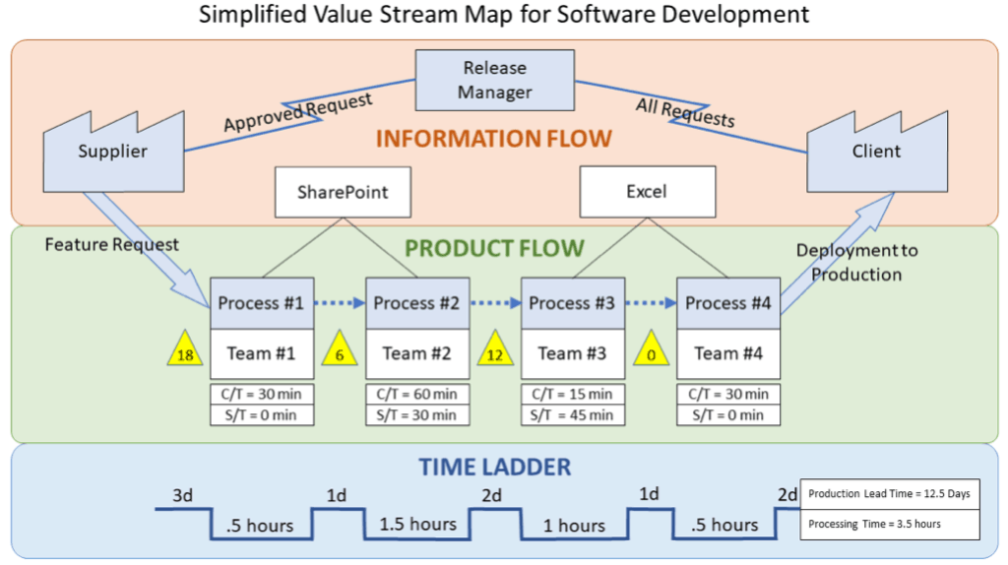
Value Stream Mapping
The VSM enables the team and leadership to see where the actual value is being added in the process, allowing them to improve on the overall efficiency associated with the delivery of a software product or feature request

Slide 21
Value Stream Mapping - Exercise
Work deployed
Work received
Lead Time
Idle time
Cycle Time – Development and Delivery cycle

Slide 22
Value Stream Mapping - Exercise
Work in production
Work received
Lead Time
Idle time
Cycle Time – Development and Delivery cycle
Idle time
Development Code Cycle
Testing
Performance Testing
Deploy to Production

Slide 23
Value Stream Mapping - Exercise
Work in production
Work received
Lead Time
Idle time
Cycle Time – Development and Delivery cycle
Idle time
Development Code Cycle
Testing
Performance Testing
Deploy to Production
New features
Bug fixing
(Manual + Automated Test)
Bug fixing
(Perf Test)
Change request

Slide 24
Value Stream Mapping - Exercise
Work in production
Work received
Lead Time
Idle time
Cycle Time – Development and Delivery cycle
Idle time
Development
Testing
Performance Testing
Deploy to Production
Manual Testing
Automated Tests
Test re-validation

Slide 25
Value Stream Mapping - Exercise
Work in production
Work received
Lead Time
Idle time
Cycle Time – Development and Delivery cycle
Idle time
Development
M. Testing
AT
Performance Testing
Deploy to Production
Approval Process
Back Up
Deployment

Slide 26
Value Stream Mapping - Idle Time – Cause and actions
Work in production
Work received
Lead Time
Idle time
Cycle Time – Development and Delivery cycle
Idle time
Development
Idle
M. Testing
AT
Idle
Performance Testing
Idle
Approval
Back up
Deploy to Production
New Item throughput is bigger than development throughput
Increase the Dev Team or Reduce “waste” time in Development Phase
Test team cannot accept new version because of a long Manual Test cycles
Long Manual Test Cycles and Test re-validation after bug fixes are producing a queue before executing Performance Testing
Uncertainty of delivering new version because high production bug ration

Slide 27
Value Stream Mapping - Development – Cause and actions
Work in production
Work received
Lead Time
Idle time
Cycle Time – Development and Delivery cycle
Idle time
Development
Idle
M. Testing
AT
Idle
Performance Testing
Idle
Approval
Back up
Deploy to Production
1/3 of the time spent in bug fixing and rework because of change requests
Increase the code quality (reduce bugs)
Prevent changing the initial scope of work defined
Scale up the team

Slide 28
Value Stream Mapping Development – Cause and actions
Work in production
Work received
Lead Time
Idle time
Cycle Time – Development and Delivery cycle
Idle time
Development
Idle
M. Testing
AT
Idle
Performance Testing
Idle
Approval
Back up
Deploy to Production
Majority of the time spent in manual testing and revalidation of failed tests
Automate the tests as much as possible (reduce test cycle)
Increase the team members
Provide qualitative bug description so devs can easily identify, reproduce and resolve the problems

Slide 29
Value Stream Mapping - Production – Cause and actions
Work in production
Work received
Lead Time
Idle time
Cycle Time – Development and Delivery cycle
Idle time
Development
Idle
M. Testing
AT
Idle
Performance Testing
Idle
Approval
Back up
Deploy to Production
Remove Production Deployment uncertainty by
Reduce bureaucracy time (Business Readiness, Approval, etc.)
Implement some Deployment Strategy (Blue/Green, Canary, Feature Toggles etc.)
Mitigate the risk by providing Disaster Recovery environment

Slide 30
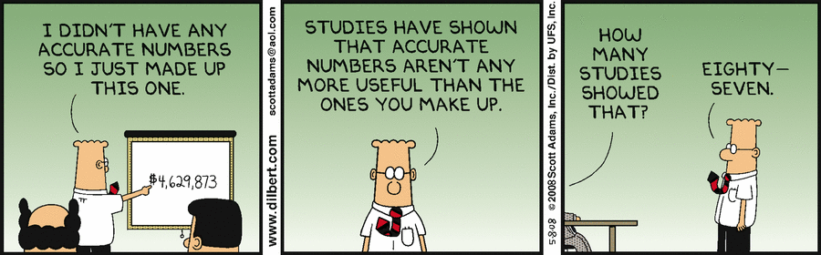
“If you cannot measure it, you can’t control it.” - Lord Kelvin

Slide 31
